Slide 1
2
Current Situation
Drugs
Alcohol/Tobacco

Slide 2

What are Drugs Literally?
China’s Criminal Law:
Narcotic drugs (麻醉药品) and psychotropic drugs（精神药品） which can make people addict to.
Narcotic drugs: Marijuana; opium; cocaine (highly addictive)
Narcotic and psychotropic drugs management law: 371 kinds of drugs
A relative concept:
whether they are abused or cause addiction.
Published in 2005

Slide 3
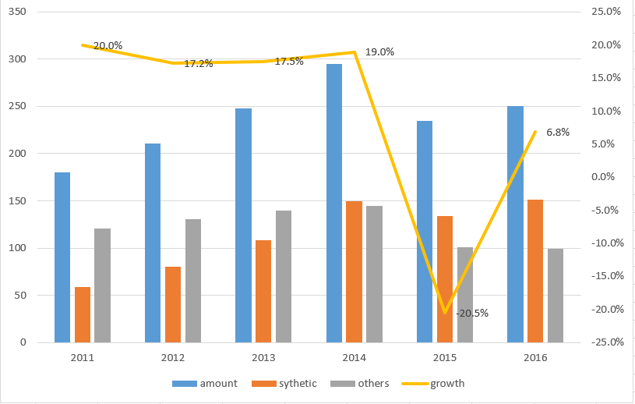
Prevalence & Incidence
10-thousand
Growth rate
2.5 million registered drug addicts
According to international common, the ratio of the registered and the unregistered is 1:5.
Average age: 28 y.o
14 million drug addicts
About one in every 100 people.

Slide 4
Prevalence & Incidence
10-thousand
Growth rate
Synthetic Drugs grows stably
with a 30% increase rate
Synthetic Drugs: chemical synthesis ecstasy(摇头丸); K powder; crystal meth(冰毒)
Traditional ones: extract from plants
opium; heroin

Slide 5
Prevalence & Incidence

Slide 6
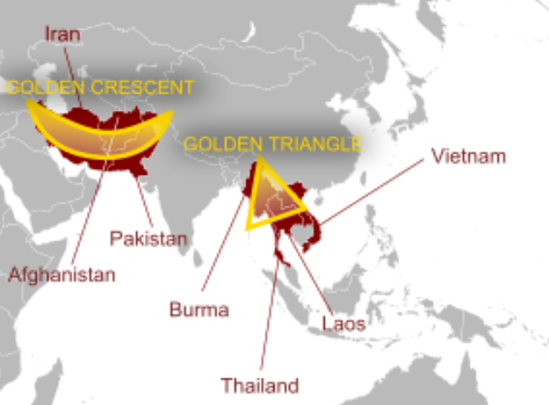
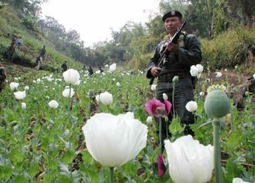
Origins & Channels
90% from Golden Triangle
Others from Golden crescent or made in China
Yunnan; Guangdong; Guangxi; Sichuan; Xinjiang
Mainly by internet.
Wechat pay/ Ali pay
Forums
Social media groups

Slide 7
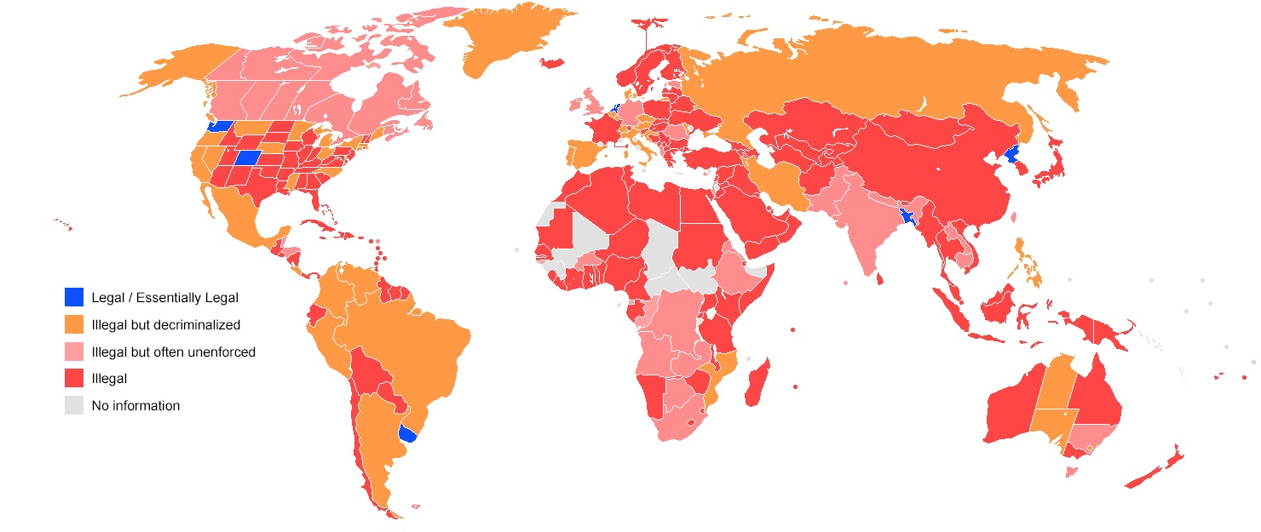
Strict Management
Whether Marijuana is legal or illegal ?
Source: Wikipedia

Slide 8

Strict Management
One of the strictest counties of drug control.
The dynamic control system:
A system that copies all the personal information of the registered drug addicts or others who have committed a crime of drugs before. Once the people in the system uses his/her own personal identification, (eg. Using a bank card; staying at a hotel etc.), the system will alert the near police to check the person in a short time.
Published in 2008

Slide 9
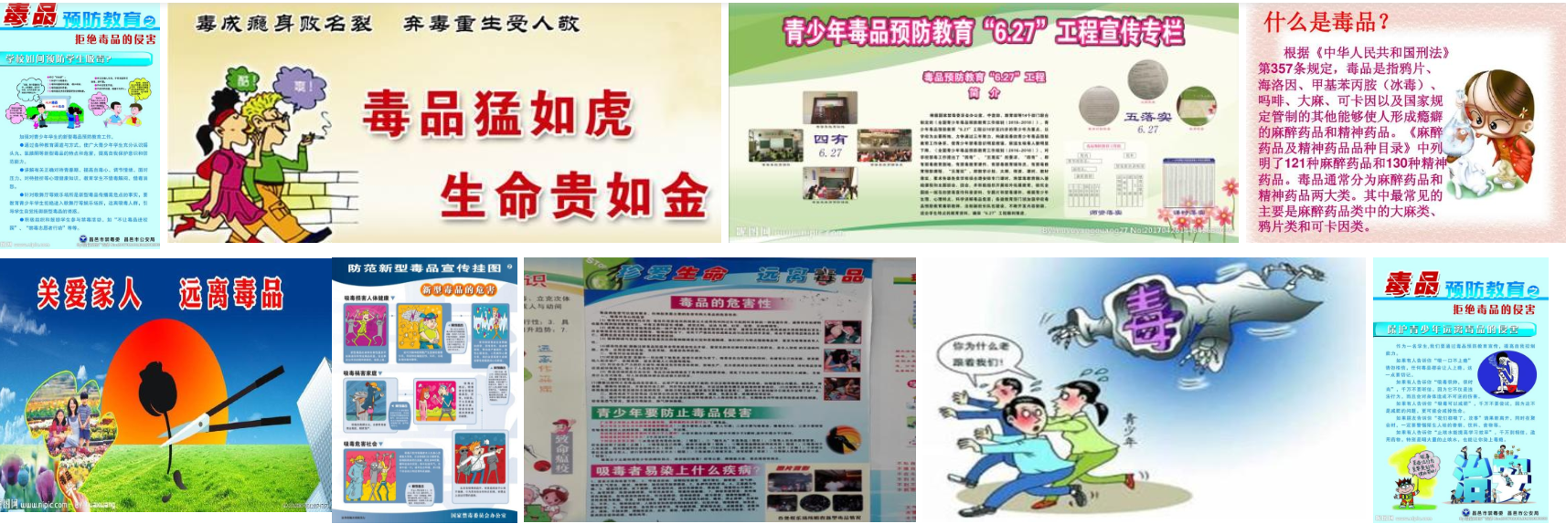
The public awareness
Education – emphasis on “SAY NO” attitude
Focus on Primary & Junior school
Exhibition / Theme class meeting / Lecture
Included in textbooks or exams.
e.g. Drug prevention knowledge should be permeated in Entrance examination for secondary school in Gansu Province

Slide 10
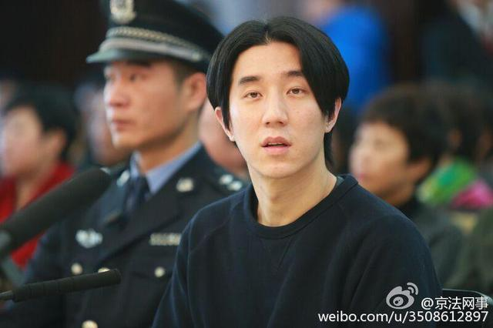
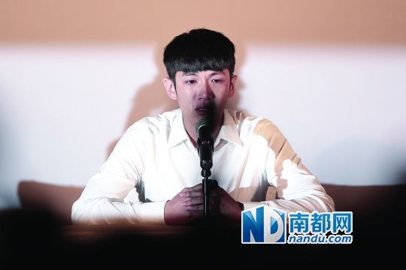

The public awareness
2. Drug abuse cases of public figures alert the public.
12 public figures were arrested and imprisoned in 2014.
Censorship: State Administration of Radio, Film and Television (广电总局) 2014
All the work which the misdeed public figures involved in are banned.

Slide 11
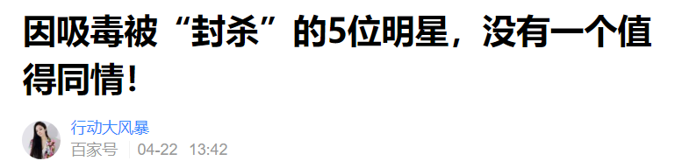

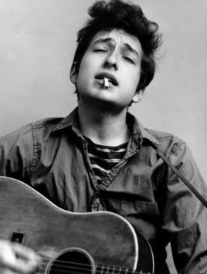
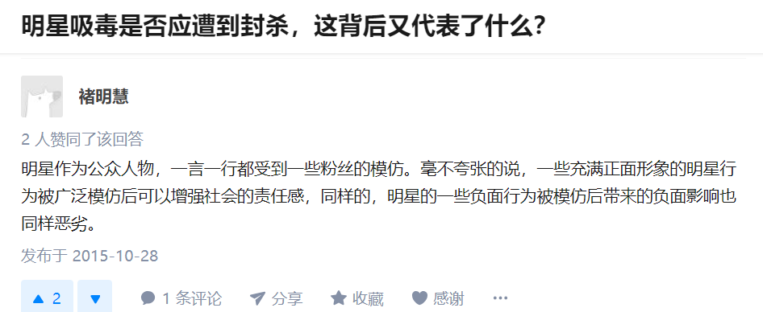
The public awareness
2. Drug abuse cases of public figures alert the public.
Comparison of Tendency of public opinion
They deserve it. Without empathy.
A mistake, but can be forgiven.
Doesn’t matter a lot. A way of recreation.
Obama, Bob Dylan, John Lennon, Lady Gaga etc..

Slide 12
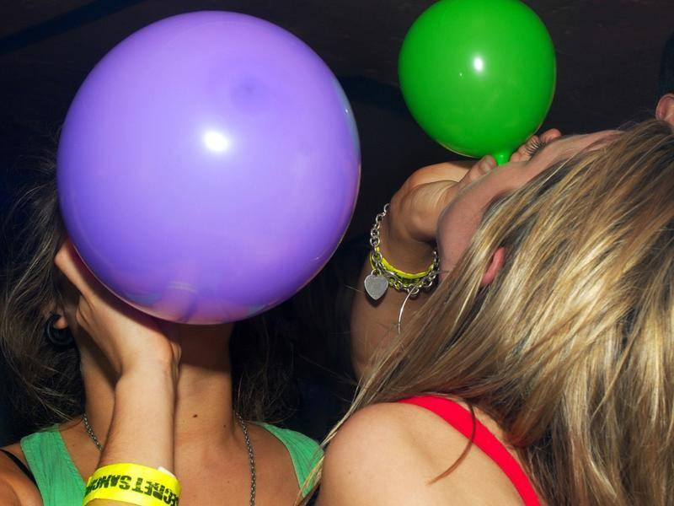
Another example ：“笑气”
Cannot stop laughing
GAS: N2O（Nitrous Oxide氧化亚氮）
Currently not included in the management law.
Traditional Use: anesthetic; food processing
Cause Paralysis.

Slide 13
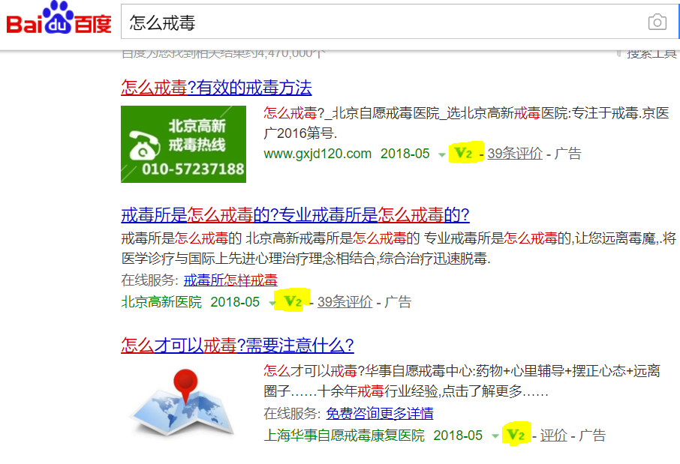
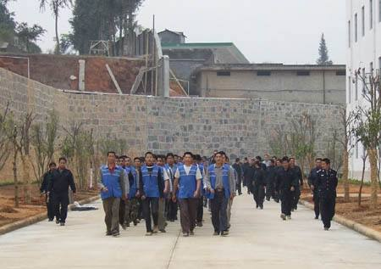
Measurement Access
2 ways to get treatment:
compulsory rehabilitation center --- managed by police / judiciary
amount: about 700 capacity: 350 000
Medical institutions – supervised by the health authorities
Internet access - ads

